Slide 1

TRAVELLING SALESMAN PROBLEM
USING
GENETIC ALGORITHM

Slide 2
What is Travelling Salesman Problem ?
The traveling salesman problem (TSP) is an algorithmic problem tasked with finding the shortest route between a set of points and locations that must be visited.
In the problem statement, the points are the cities a salesperson might visit. The salesman‘s goal is to keep both the travel costs and the distance travelled as low as possible.
Applications
Focused on optimization, TSP is often used in computer science to find the most efficient route for data to travel between various nodes. Applications include identifying network or hardware optimization methods.

Slide 3
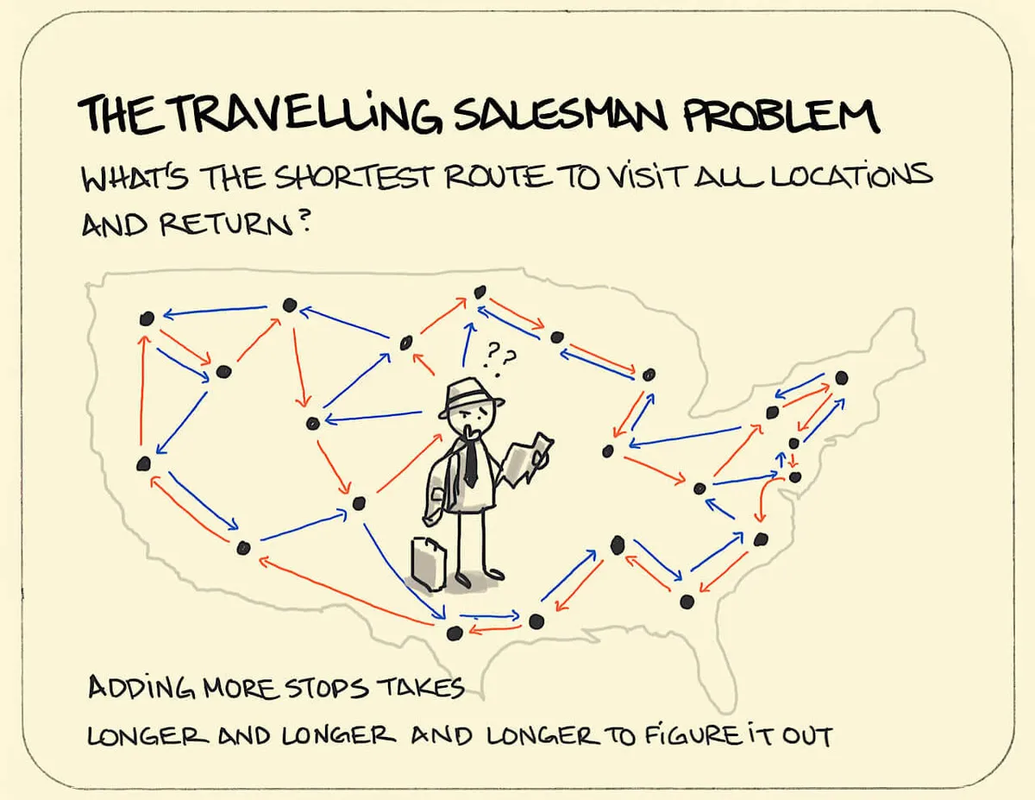

Slide 4
Let's get into the main topic i.e 'Genetic Algorithm' ….

Slide 5
What is Genetic Algorithm ?
Genetic Algorithms(GAs) are adaptive heuristic search algorithms that belong to the larger part of evolutionary algorithms.
Genetic algorithms are based on the ideas of natural selection and genetics. These are intelligent exploitation of random search provided with historical data to direct the search into the region of better performance in solution space.
They are commonly used to generate high-quality solutions for optimization problems and search problems.
Genetic algorithms simulate the process of natural selection which means those species who can adapt to changes in their environment are able to survive and reproduce and go to next generation.
In simple words, they simulate “survival of the fittest” among individual of consecutive generation for solving a problem. Each generation consist of a population of individuals and each individual represents a point in search space and possible solution.
Each individual is represented as a string of character/integer/float/bits. This string is analogous to the Chromosome.

Slide 6
Foundation of Genetic Algorithms
Genetic algorithms are based on an analogy with genetic structure and behaviour of chromosomes of the population. Following is the foundation of GAs based on this analogy –
Individual in population compete for resources and mate
Those individuals who are successful (fittest) then mate to create more offspring than others
Genes from “fittest” parent propagate throughout the generation, that is sometimes parents create offspring which is better than either parent.
Thus each successive generation is more suited for their environment.

Slide 7
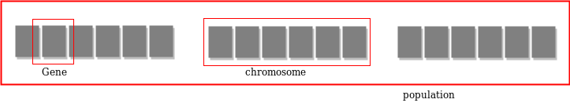
Search Space
The population of individuals are maintained within search space. Each individual represents a solution in search space for given problem. Each individual is coded as a finite length vector (analogous to chromosome) of components. These variable components are analogous to Genes. Thus a chromosome (individual) is composed of several genes (variable components).

Slide 8
Fitness Score
A Fitness Score is given to each individual which shows the ability of an individual to “compete”. The individual having optimal fitness score (or near optimal) are sought.
Operators of Genetic Algorithms
Once the initial generation is created, the algorithm evolves the generation using following operators –
Selection Operator: The idea is to give preference to the individuals with good fitness scores and allow them to pass their genes to successive generations.
Crossover Operator: This represents mating between individuals. Two individuals are selected using selection operator and crossover sites are chosen randomly. Then the genes at these crossover sites are exchanged thus creating a completely new individual (offspring).
Mutation Operator: The key idea is to insert random genes in offspring to maintain the diversity in the population to avoid premature convergence.

Slide 9
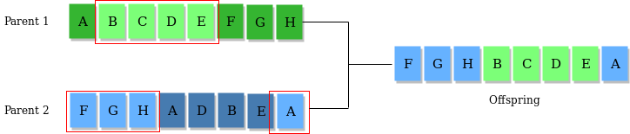
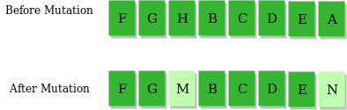
Crossover Operator -
Mutation Operator -​

Slide 10
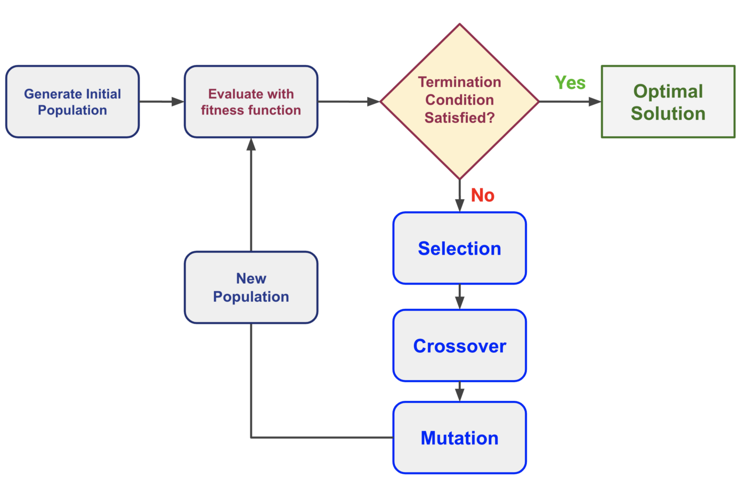
The step-wise process in Genetic Algorithm :

Slide 11
Now let's get into the coding part...

Slide 12
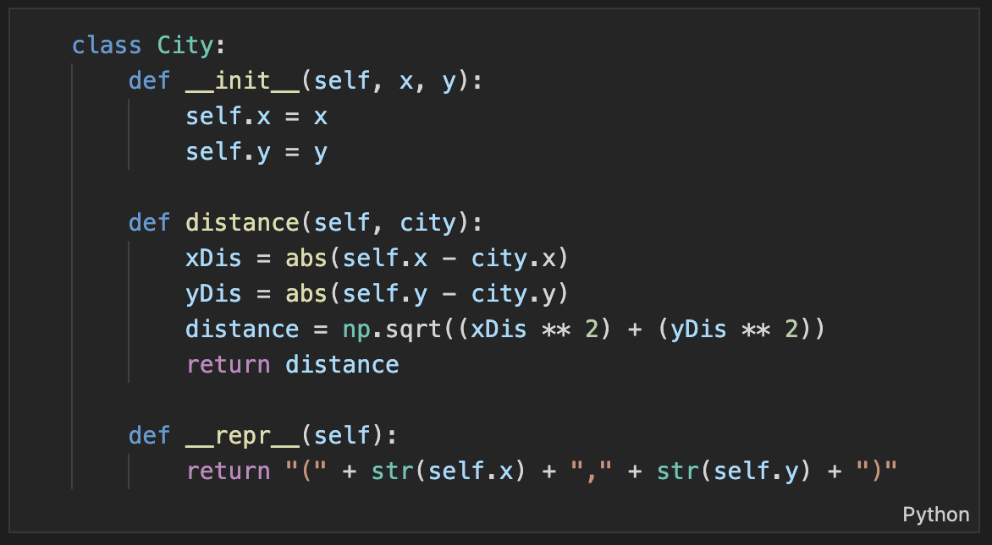
City's Representation

Slide 13
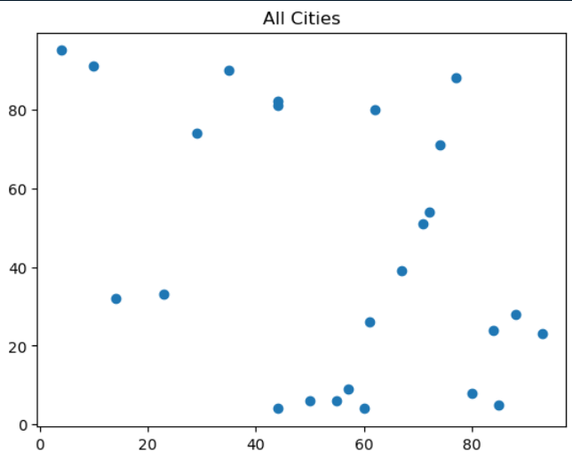

Slide 14
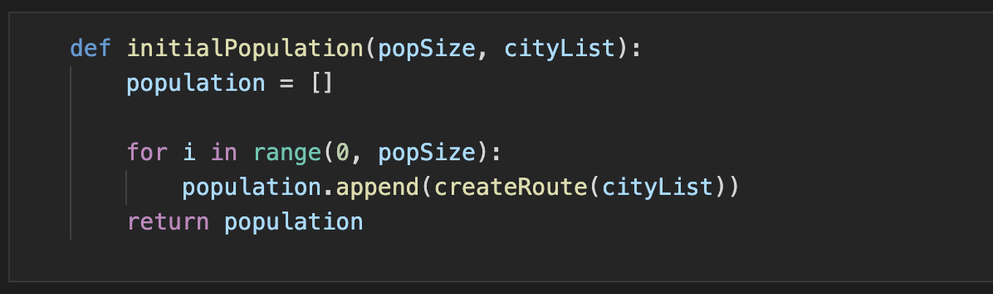
Initialisation

Slide 15
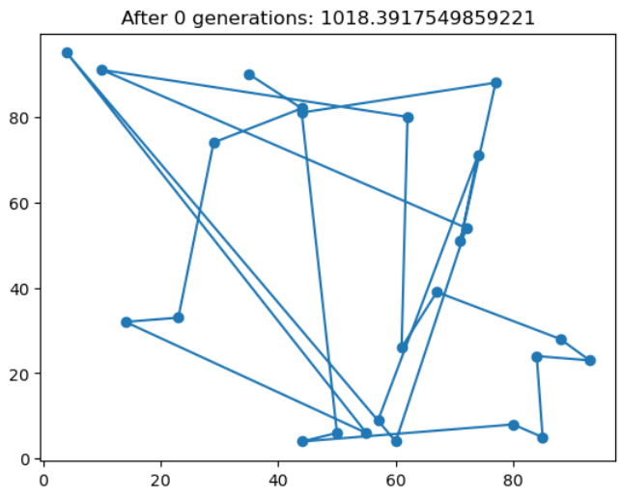

Slide 16
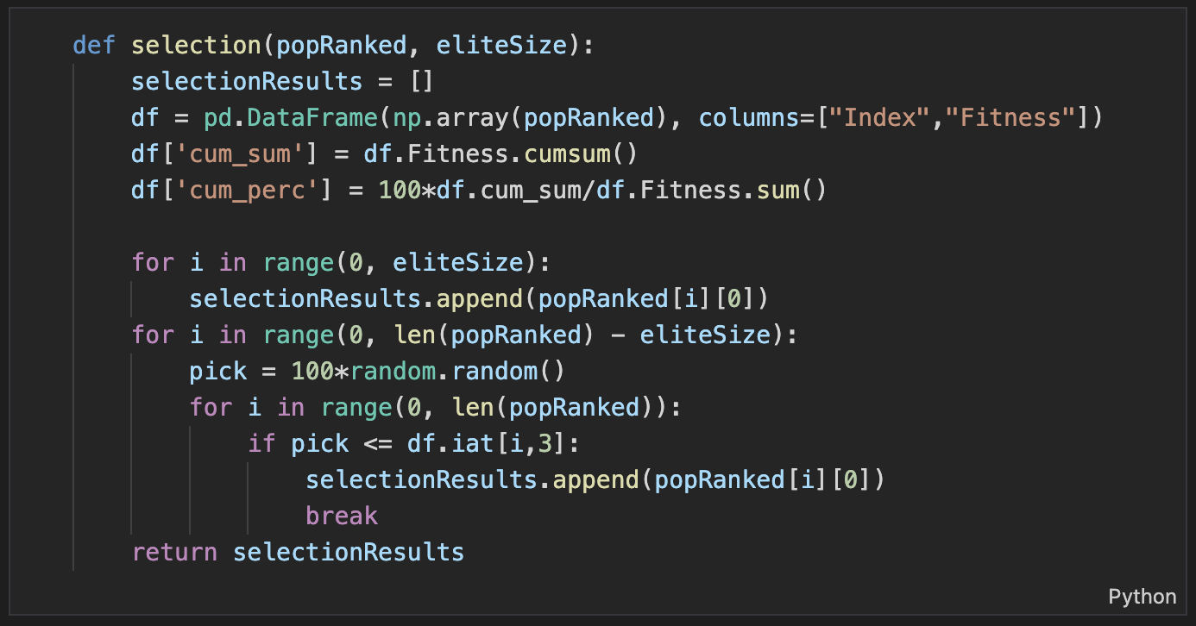
Selection

Slide 17
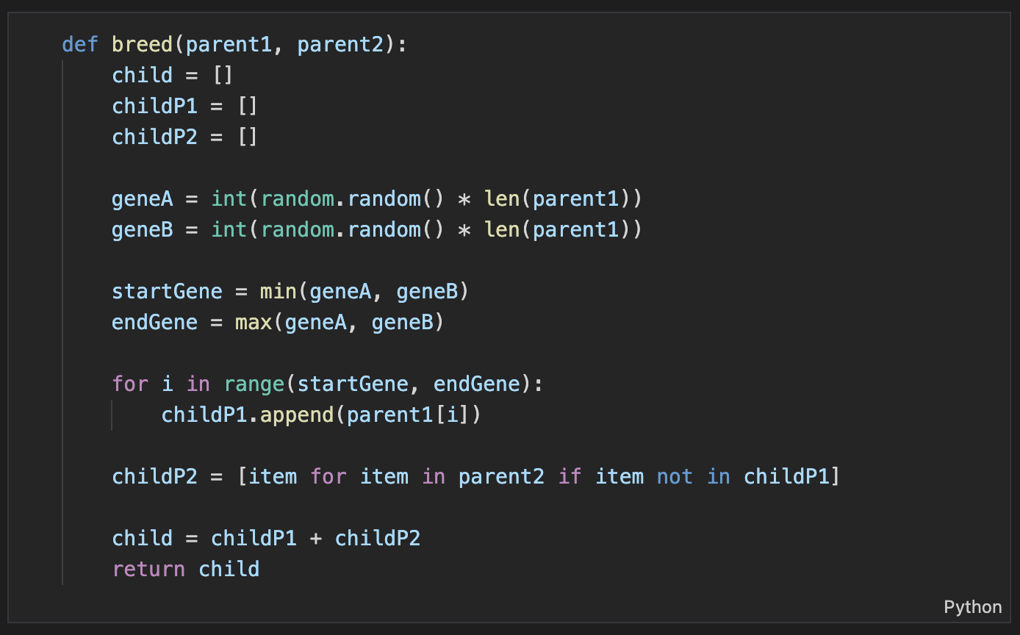
Crossover

Slide 18
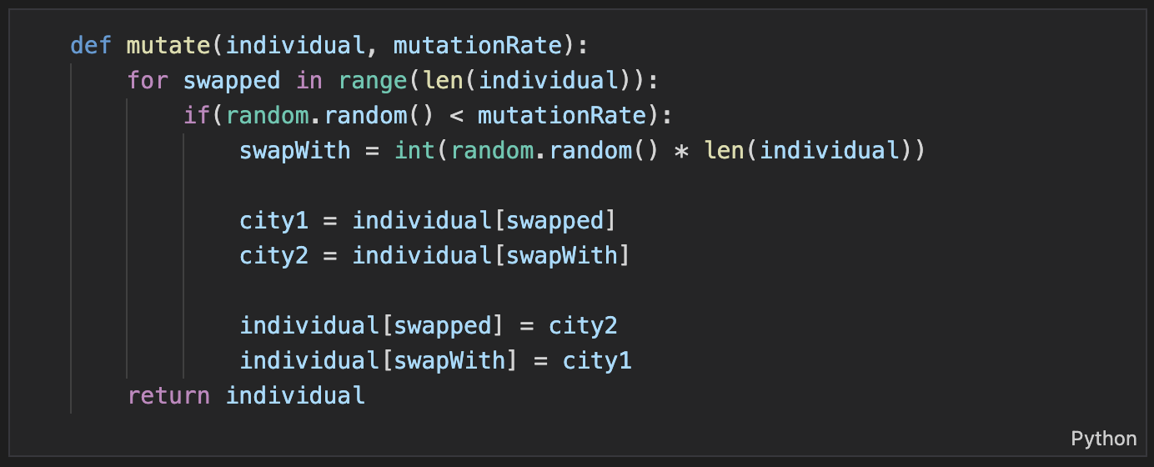
Mutation

Slide 19
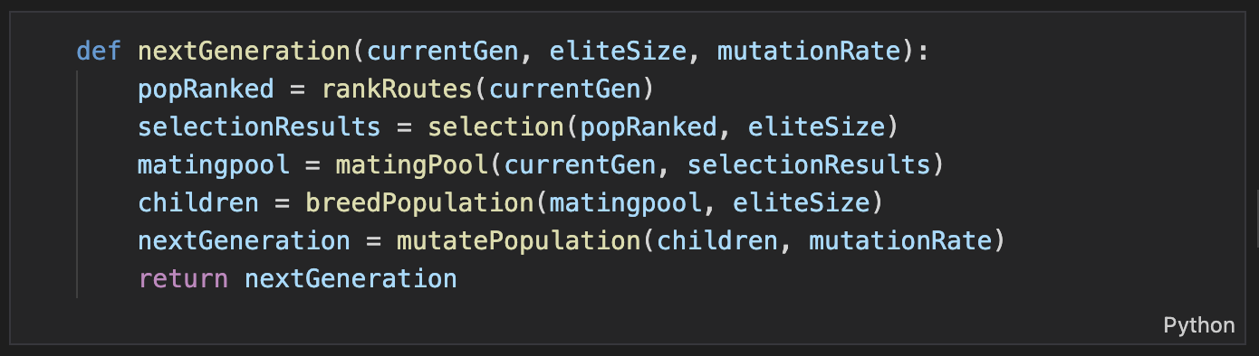
Next Generation

Slide 20
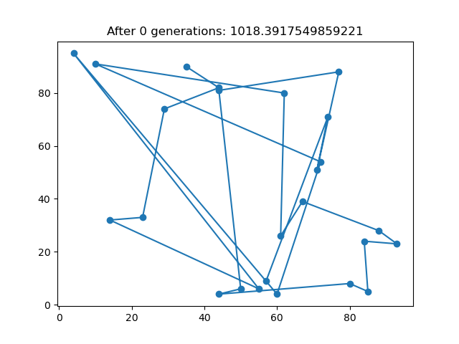
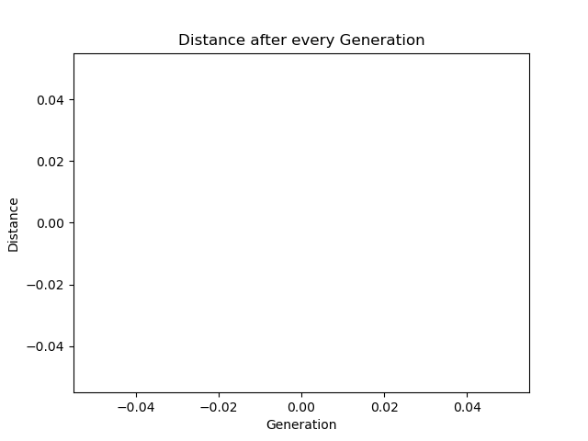
Iterating through 500 generations

